Slide 1
Population continued

Slide 2
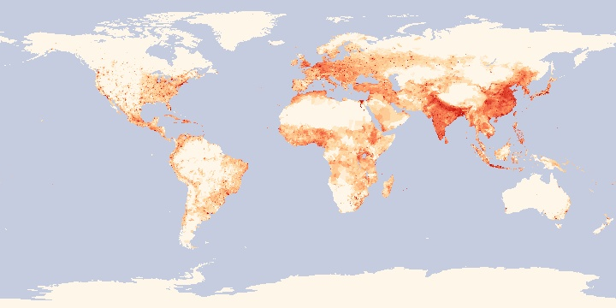
World population map – based on 2000 census data
Write down patterns you observe
Neo.sci.gsfc.nasa.gov
Notes:
This map is broken up into grids showing number of people per square kilometer. The most densely populated areas are bright red; these include large cities all over the world. Another obvious population pattern is the big difference in population between Earth's most populated countries — China and India — and other countries.

Slide 3
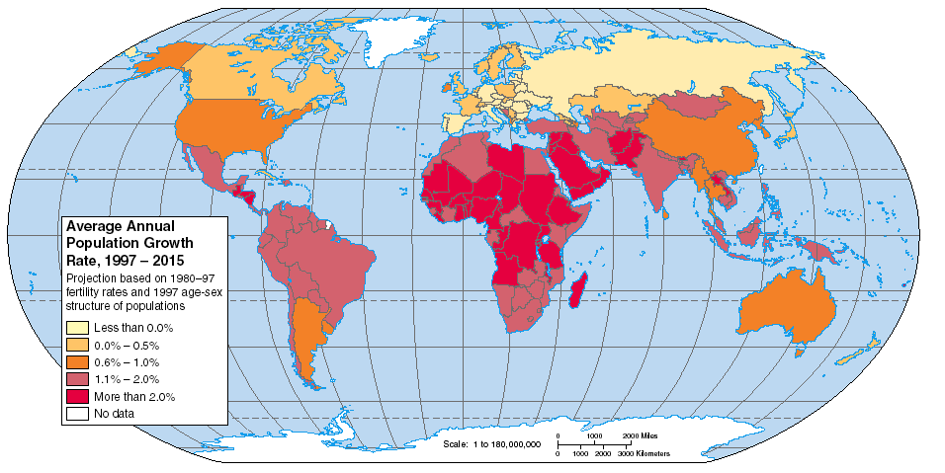
Population growth rates – by country
Write down patterns you observe

Slide 4
Pair-share
Compare
What are differences between these two data sets?
What might explain the differences?
Notes:
Why does growth rate NOT correlate with high population density?

Slide 5
Factors affecting Growth Rate
Growth rate = Birth Rate - Death Rate
1.1% = 1.9% - 0.8% (as of 2012)
Death rates have largely stabilized globally...
So… Birth Rate is the most important contributor to population growth
specifically the Fertility Rate (average #children per woman)
Notes:
High population does not = high birth rate

Slide 6
Factors affecting Birth Rate
Varies inversely with industrialization
Global BR = 1.9% (higher in developing countries)
Lessons on population control from Thailand, South Korea, Japan, India, and China:
Invest in Family Planning
Reduce poverty
Elevate the status of women
Notes:
We discussed these factors last class

Slide 7
Factors affecting Death Rate
Global DR = 0.8% (equal between developing and developed countries)
Low death rates due to:
medical treatments
better food availability and nutrition
improvements in sanitation
access to clean water
Lower DR is the main reason for the global population increase

Slide 8
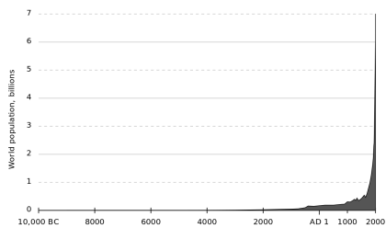
World population, billions
Lower DR is the main reason for the global population increase

Slide 9
Carrying Capacity
At the heart of this issue is the concept of Carrying Capacity (K)
the maximum number of individuals that the environmental resources of a given region can support.
Do you think we will reach a carrying capacity?
Population growth and Carrying Capacity co-evolve.
Factors: Technology, social, political, economic institutions, physical & ecological environment.

Slide 10
Carrying Capacity
Physical carrying capacity = “packing density”, limited only by space and resources
Cultural carrying capacity is always less – quality of life
Still there is a large difference of opinion regarding how many people the earth can support.
Accepted range for K is 10-20 billion people

Slide 11
Demographic Transition
Refers to the impact of economic development on birth and death rates.
Responsible for the gradual reduction in pop growth rates during the late-20th century
First noted by demographers for changes in 19th-century Europe, the DT is a critical shift in population growth and age structures that differentiate developed nations from developing nations

Slide 12
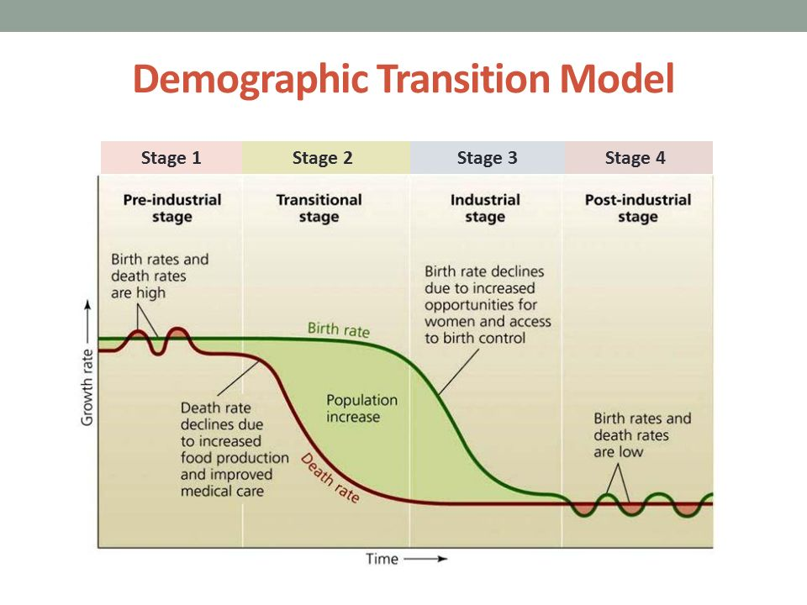

Slide 13
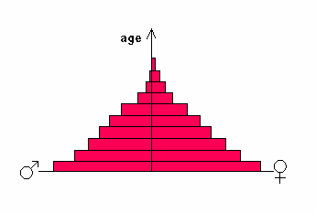
Age
Population in age class

Slide 14
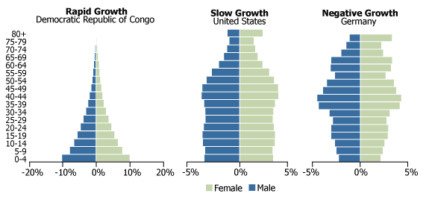

Slide 15
Population and Consumption Exercise
Industrial Nations (First world – more developed)
20% of population
80% of consumption
All others (Third world – less developed)
80% of population
20% of consumption
Given these rough estimates…
Notes:
15

Slide 16
Calculate relative resource use.
20% of population (in MDCs) uses 80% of resources.
0.2 * R1 = 0.8
R1 = 0.8 / 0.2 = 4
(We use about 4 times the average.)
80% of population (in LDCs) use 20% of resources.
0.8 * R2 = 0.2
R2 = 0.2 / 0.8 = 0.25
(LDCs use about ¼ of the average.)
Notes:
Actual resource use varies by resource, and the difference is much higher for many resources.
16

Slide 17
What if the world consumed like us?
Today’s total consumption:
MDC consumption + LDC consumption = today’s use.
80% + 20% = 100%
MDC pop. * MDC per cap use +
20% * 4 times average + 80% * ¼ times average = 100%
Fully industrialized total consumption:
100% * 4 = 400% (!)
Notes:
17

Slide 18
Is this supportable?
- We would run out of oil approx. 4 times as fast.
- We would have 4 * the demand for raw materials.
- We would have 4 * the demand for steel and other industrial products.
The third world would in theory eat a similar calorie and meat diet in this scenario.
They also would adopt our approach wholesale.
What if LDC population doubles?
Notes:
18

